Slide 2
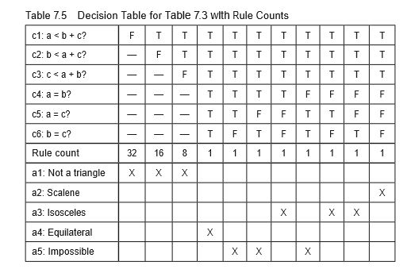
Decision Table for Triangle Program

Slide 3
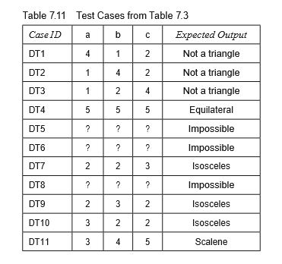
Test Case Table for Triangle problem

Slide 4
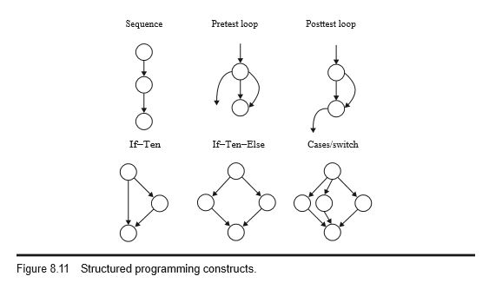
Path Testing

Slide 5
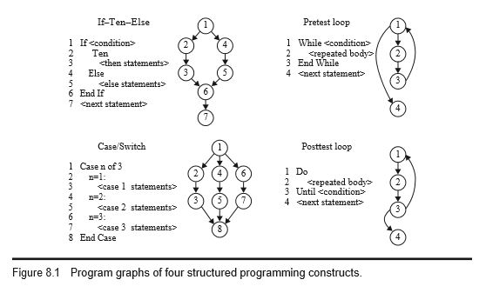
Path Testing

Slide 6
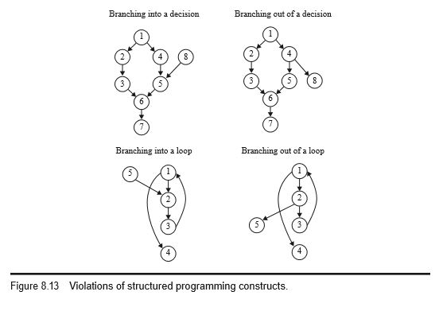
Path Testing

Slide 7
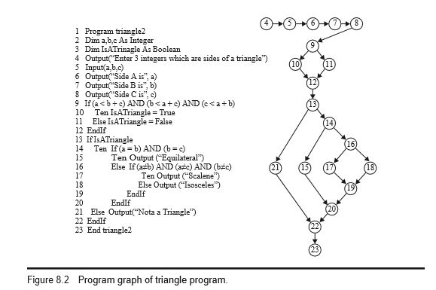
Path Testing

Slide 8
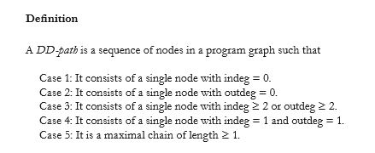
DD-paths

Slide 9
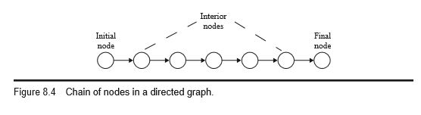
Chain of Nodes

Slide 10
Test Coverage Metrics
Program Graph–Based Coverage Metrics
E.F. Miller’s Coverage Metrics contd..

Slide 11
1. Program Graph–Based Coverage Metrics
Given a program graph, we can define the following set of test coverage metrics.
Gnode :Given a set of test cases for a program, they constitute node coverage if, when executed on the program, every node in the program graph is traversed. Denote this level of coverage as Gnode, where the G stands for program graph.
Gedge : Given a set of test cases for a program, they constitute edge coverage if, when executed on the program, every edge in the program graph is traversed. Denote this level of coverage as Gedge.
Gchain :Given a set of test cases for a program, they constitute chain coverage if, when executed on the program, every chain of length greater than or equal to 2 in the program graph is traversed. Denote this level of coverage as Gchain.
Gpath : Given a set of test cases for a program, they constitute path coverage if, when executed on the program, every path from the source node to the sink node in the program graph is traversed. Denote this level of coverage as Gpath.

Slide 12
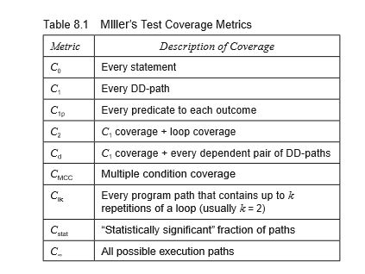
2. E.F. Miller’s Coverage Metrics
a. Statement Testing:

Slide 13
2. E.F. Miller’s Coverage Metrics contd..
b. DD-Path Testing :
When every DD-path is traversed (the C1 metric), we know that each predicate outcome has been executed; this amounts to traversing every edge in the DD-path graph (or program graph). Therefore, the C1 metric is exactly our Gchain metric. For if–then and if–then–else statements, this means that both the true and the false branches are covered (C1p coverage).
c. Simple Loop Coverage :
The simple view of loop testing is that every loop involves a decision, and we need to test both outcomes of the decision: one is to traverse the loop, and the other is to exit (or not enter) the loop.

Slide 14
2. E.F. Miller’s Coverage Metrics contd..
d. Predicate Outcome Testing :
This level of testing requires that every outcome of a decision (predicate) must be exercised.
e. Dependent Pairs of DD-Paths :
The most common dependency among pairs of DD-paths is the define/reference relationship, in which a variable is defined (receives a value) in one DD-path and is referenced in another DD-path. The importance of these dependencies is that they are closely related to the problem of infeasible paths.
f. Complex Loop Coverage:
Miller’s metric extends the loop coverage metric to include full paths from source to sink nodes that contain loops, which are a highly fault-prone portion of source code.

Slide 15
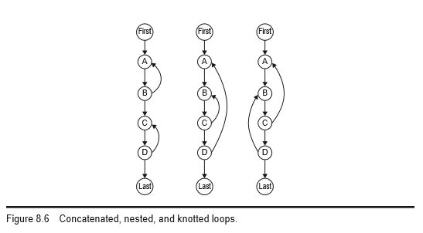
2. E.F. Miller’s Coverage Metrics contd..

Slide 16
2. E.F. Miller’s Coverage Metrics contd..
Concatenated loops are simply a sequence of disjoint loops, while nested loops are such that one is contained inside another. Knotted (Beizer calls them “horrible”) loops cannot occur when the structured programming precepts are followed, but they can occur in languages like Java with try/catch.
g. Multiple Condition Coverage:
Miller’s CMCC metric addresses the question of testing decisions made by compound conditions. Instead of simply traversing such predicates to their true and false outcomes, we should investigate the different ways that each outcome can occur. One possibility is to make a decision table; a compound condition of three simple conditions will have eight rules, yielding eight test cases.

Slide 17
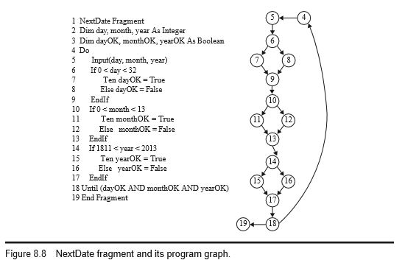
Fragment of NextDate Program Graph

Slide 18
Basis path testing
McCabe based his view of testing on a major result from graph theory, which states that the cyclomatic number of a strongly connected graph is the number of linearly independent circuits in the graph. We can always create a strongly connected graph by adding an edge from the (every) sink node to the (every) source node.
Cyclomatic Complexity formula is V(G) = e – n + p, while others use the formula V(G) = e – n + 2p;
Everyone agrees that
e is the number of edges
n is the number of nodes
p is the number of connected regions.

Slide 19
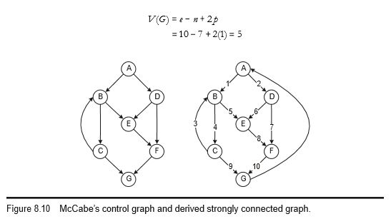
Basis path testing contd…

Slide 20
Basis path testing contd…
There are five linearly independent circuits. If we now delete the added edge from node G to node A, these five circuits become five linearly independent paths from node A to node G.
p1: A, B, C, G
p2: A, B, C, B, C, G
p3: A, B, E, F, G
p4: A, D, E, F, G
p5: A, D, F, G

Slide 21
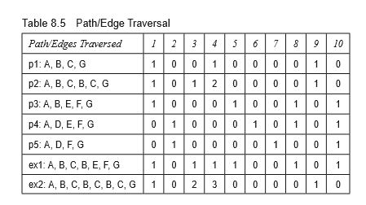
Basis path testing contd…

Slide 22
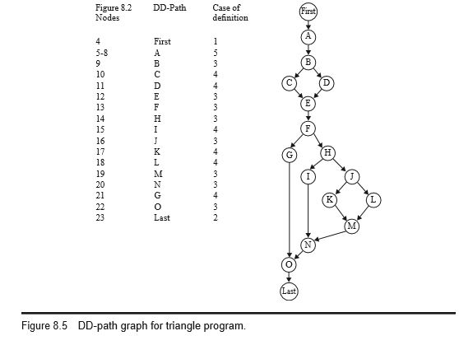
Basis path testing contd…

Slide 23
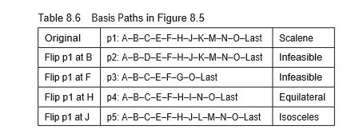
Basis path testing contd…

Slide 24
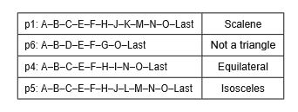
Basis path testing contd…

Slide 25
Guidelines and Observations
specification-based testing, we observed that gaps and redundancies can both exist and, at the same time, cannot be recognized.
The path testing approaches to code-based testing represent the case that is present in the code, in particular the distinction between feasible and infeasible paths.
Path-based testing also provides us with a set of metrics that act as crosschecks on specification-based testing.
Basis path testing therefore gives us a lower boundary on how much testing is necessary.

